Slide 1


IcoaPP
An application to improve the patient-hospital experience at ICO centers.
Manel Ferrer Martin
Javier Martín Cereceto
Yahya El Kajouai
2 DAW Morning

Slide 2
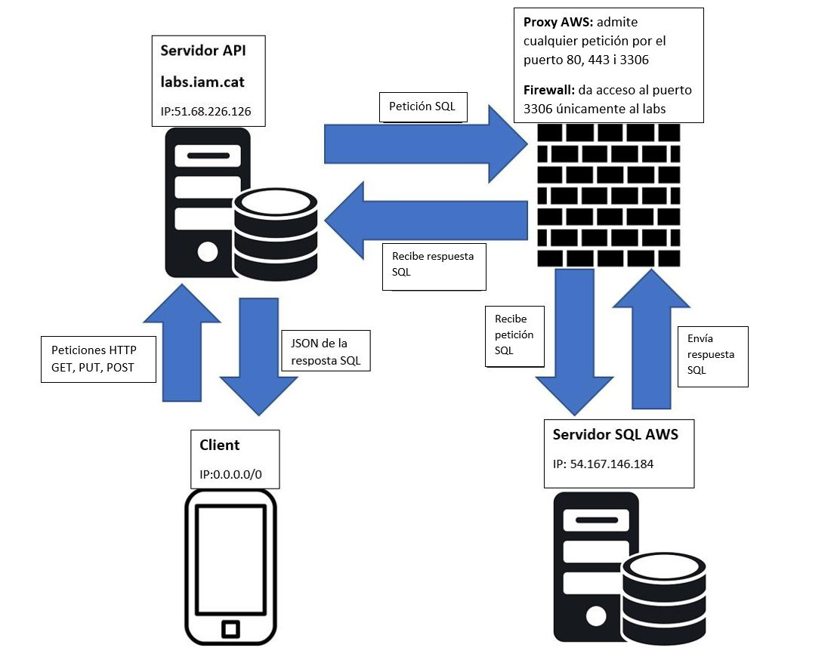

Slide 3
Abstract
Based on the need of the “Institut de Catalunya d’Oncologia” to improve the patient-hospital experience, we have created an application that allows:
- See quotes
- View medication
- View ICO hospitals
- View contacts
- View your profile
- Be able to talk to other patients in a way find psychological help

Slide 4









Slide 5

Use of the app

